Slide 1
Lecture 7 Supplement: A Review of Nested Classes

Slide 2
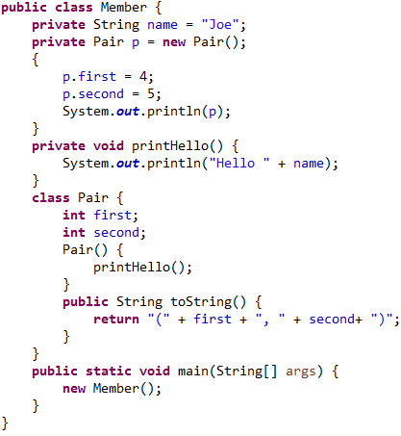
Member Inner Classes
Accessible only when an instance of enclosing class exists, and when inner class has been instantiated
Have access to private members of enclosing class
May be declared private, public, etc
Cannot contain static variables or methods
Enclosing class can access private members of inner class, relative to an existing reference
Best Practice: Should be accessed only by the enclosing class

Slide 3
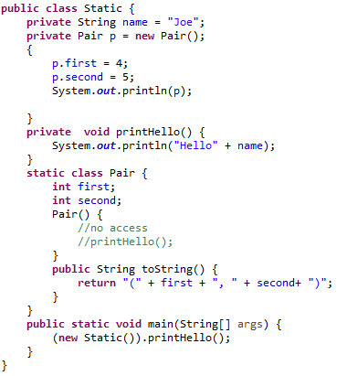
Static Nested Classes
Considered a "top-level class", packaged inside another class
May be instantiated even if enclosing class has not been instantiated
No access to non-static members of enclosing class without a reference (with a reference, can access private members)
Direct access to static members
May be declared private, public, etc
May contain static and non-static members
Enclosing class can access private members of nested class, relative to an existing reference

Slide 4
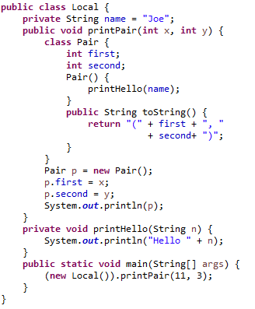
Local Inner Classes
Always defined within a method body – never accessible from outside the method in which it is defined
Has access to all members of enclosing class
Has access to local variables, but may not modify them (they are "effectively final")
Access specifiers (public, private…) may not be used in definition of a local inner class
Local inner classes provide strong encapsulation – no other method in the enclosing class (or anywhere else) can access it.

Slide 5
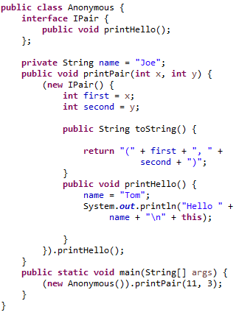
Anonymous Inner Classes
Defines and instantiates, at the same time, a class, without giving it a name
The syntax can be used to define a subclass of a given class or an implementation of a given interface
Main usage: when class definition involves few lines of code and the class needs to be defined only once (example: attaching a handler to a button)

